Slide 1
INVESTMENT ASSIGNMENT SUBMISSION
Name:
Ajay Shekhawat

Slide 2
Sparks Funds – Investment Analysis
Spark Funds wants to make investments in a few companies. The overall strategy is to invest where others are investing, implying that the 'best' sectors and countries are the ones 'where most investors are investing’.
Business Constraints :
It wants to invest between 5 to 15 million USD per round of investment
It wants to invest only in English-speaking countries because of the ease of communication with the companies it would invest in.
Business Objective :
To identify the best sectors, countries, and a suitable investment type for making investments.
Goals of Data Analysis :
Funding type analysis (Understand the funding type best suited for investment)
Country specific analysis (Understanding which countries have been the most heavily invested)
Sector Analysis (Understanding the distribution of investments across the main sectors)

Slide 3
Problem Solving Approach
Import data from CSV/TXT files
Cleaning data and merging the datasets
Funding Type Analysis
Filter Data acc. to the chosen Investment Type
Country Analysis
Finding the top 3 English speaking countries
Map the primary sectors to Main Sector using mappings file
Sector Analysis(Identifying the main sectors for Investment)
Suggestions according to Analysis

Slide 4
Investment Type Analysis
Funding Type | Median Investment (in Millions) | Average Investment (in Millions)
Angel | 0.4 | 0.95
Private Equity | 20 | 73
Seed | 0.275 | 0.7
Venture | 5 | 11.7
Spark Funds wants to choose one of these four investment types (Angel, Seed, Venture and Private Equity) for each potential investment they will make.
Since the data had several comparatively very high values(left skewed), we have chosen median as our most representative value for analysis.
Based on our analysis, the best funding type for Spark Funds would be Venture since it is the only funding type with average/median investment between 5-15M.

Slide 5
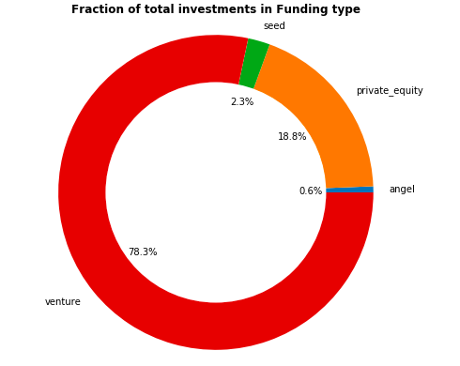
Funding Type Analysis

Slide 6
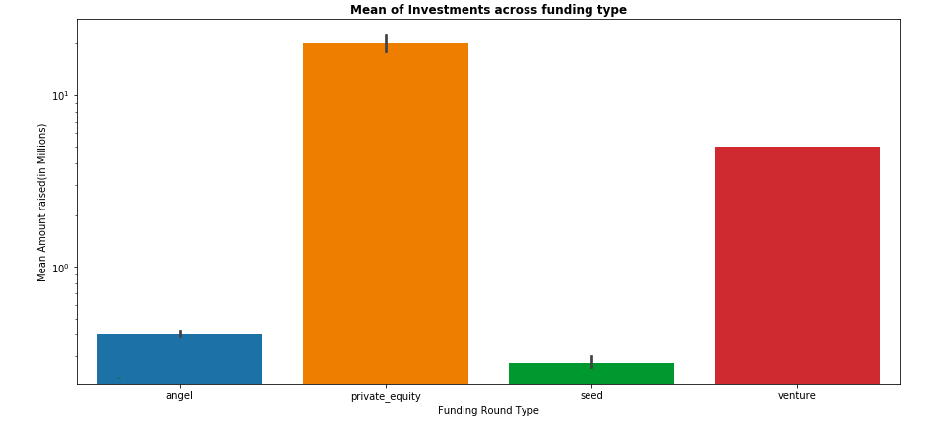
Funding Type Analysis

Slide 7
Country Analysis
Country Code | Total Investment (In Million)
USA | 420068.03
CHN | 39338.92
GBR | 20072.81
IND | 14261.51
CAN | 9482.22
FRA | 7226.85
ISR | 6854.35
DEU | 6306.92
JPN | 3167.65
We have identified the top nine countries which have received the highest total funding
USA has the most investment in the Venture Funding type.
China comes at 2nd but English is not the official language in China.
Three most investment-friendly countries and the most suited funding type for Spark Funds will include:
United States of America
United Kingdom
India

Slide 8
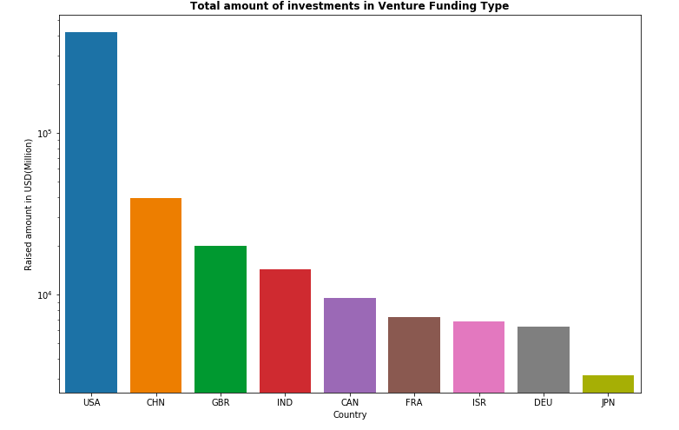
Plot showing investments across countries

Slide 9
Sector Analysis
Country | Best 3 Sectors | No. of investments in Sector | Company with Highest Investment in Sector
USA | Others | 2950 | Virtustream
 | Social, Finance, Analytics & Advertising | 2714 | SST Inc. (Formerly ShotSpotter)
 | Cleantech / Semiconductors | 2350 | Biodesix
GBR | Others | 147 | Electric Cloud
 | Social, Finance, Analytics & Advertising | 133 | Celltick Technologies
 | Cleantech / Semiconductors | 130 | EUSA Pharma
IND | Others | 110 | FirstCry.com
 | Social, Finance, Analytics & Advertising | 60 | Manthan Systems
 | News, Search and Messaging | 52 | GupShup

Slide 10
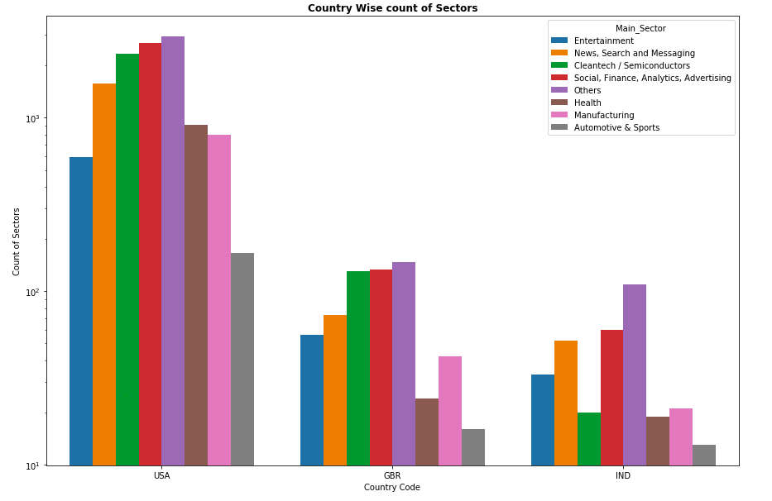
Investments across Sectors in top countries

Slide 11
Conclusion
Electric Cloud
Electric Cloud
Electric Cloud
Based on our analysis, Venture funding type is best suited for investment by Spark Funds.
Most suitable countries to invest are: USA, UK and India
The sectors to invest in these countries are as following :
1. USA :
Best Sectors : Others, Social, Finance, Analytics & Advertising and Cleantech / Semiconductor
Best Companies : Virtustream , SST Inc.
2. UK :
Best Sectors : Others, Social, Finance, Analytics & Advertising and Cleantech / Semiconductors
Best Companies : Electric Cloud , Celltick Technologies
3. India :
Best Sectors : Others, Social, Finance, Analytics & Advertising and News, Search and Messaging
Best Companies : Firstcry.com , Manthan Systems

